Slide 1

CSCE 121 Introduction to Program Design & Concepts
Stuff You Already Know, Only in C++ Now
Dr. Tim McGuire
Grateful acknowledgment to Dr. Philip Ritchey and Dr. Michael Moore for some of the material on which these slides are based.

Slide 2







Who is this guy, anyway?
Tim McGuire
B.S. in Mathematics, LeTourneau College
Minors in Mechanical Engineering and Chemistry
M.S. in Mathematics, Colorado State University
Ph.D. in Computer Science, Texas A&M University (whoop!)
45 years experience in academia and industry

Slide 3
Syllabus Review

Slide 4

Outline
Comments
Whitespace
Variables
Arithmetic
Boolean
Conditionals
Loops

Slide 5
Comments

Slide 6
How to comment
// single-line comment
/* multi-line comment */

Slide 7
Whitespace

Slide 8
Indentation
While C++ isn’t indent-sensitive like Python, it’s still good practice to indent.
Indentation should especially be used for functions, loops, conditionals, and other blocks.

Slide 9
Empty and split lines
Empty lines are useful for separating sections of code.
Split lines render easier reading and debugging.

Slide 10
C++ example with whitespace
#include <iostream>
using namespace std;
int main()
{
cout<<"Hello World";
return 0;
}

Slide 11
C++ example without whitespace
#include <iostream>
using namespace std;
int main() {
cout<<"Hello World";
return 0; }

Slide 12
Another C++ example without whitespace
#include <iostream>
using namespace std; int main() { cout<<"Hello World"; return 0; }

Slide 13
See hello.cpp in code directory

Slide 14
Variables

Slide 15
Some Definitions
Object: region of memory with a type that specifies the representation of the data stored there and what operations can be performed on it
Variable: object with a name
Value: data that may be stored in a variable
Declaration: statement that gives a name to an object
Definition: declaration that also sets aside memory for a variable
Assignment: statement that gives a value to an object
Notes:
For these simple variable examples, declaration and definition are the same.

Slide 16
Names / Identifiers
For variables, functions, types, …
Rules:
Start with a letter or underscore
Only composed of letters, digits and underscores (_)
Cannot use keywords (e.g. int, if, while, double)
By convention, variable names start with a lowercase letter and successive words are capitalized if it contains more than one word.
e.g. salesTaxRate

Slide 17
Examples
CSCE_120 //valid
121programming //invalid, starts with digit
ProfMcGuire //valid, but doesn’t follow convention
_labsux //valid, but doesn’t follow convention
int //invalid, int is a reserved word

Slide 18
Variables
Identifier is associated with a specific location in memory (i.e. address).
Use them in programs as if they were the value.
In the background, the compiler sets things up to dereference the variable identifier (i.e. get the value held in the address).
The variable type dictates how the bits will be interpreted. (More on types and data representation later…)

Slide 19
Assignment Statements
Values can be assigned to variables.
Variables must always be on the left side.
Values must always be on the right side.

Slide 20
Examples
x = 5
y = 7
z = x + y

Slide 21
Declaration, Definition, & Initialization
Declare
Say what an identifier is and what type of object it refers to.
Connects a name to an object.
Define
Sets aside memory for the variable.
Initialize
Assign value to variable for the first time.
Note: the zyBook conflates Declaration and Definition, but they are technically different.

Slide 22
Examples
int z; (declaration and definition)
extern int z; (declaration)
This is rare for variables of base types. (i.e. we won’t do this…)
int z = 7; (declaration, definition, and initialization)

Slide 23
Variable types (and byte size)
int (4)
bool (1)
char (1)
float (4)
double (8)

Slide 24
Arithmetic Operators
Addition: +
Subtraction: -
Multiplication: *
Division: /
Modulo: %
Modulo is the remainder after integer division

Slide 25
Order of operations
( ) any code in parentheses
*, /, % from left to right
+, - from left to right

Slide 26
See arithmetic.cpp in code directory

Slide 27
Control Structures

Slide 28
Structured Programming
Programmers used to use ‘goto’. This is universally considered BAD PRACTICE.
Edgar Dijkstra: Go To Statement Considered Harmful
https://homepages.cwi.nl/~storm/teaching/reader/Dijkstra68.pdf
This resulted in “Spaghetti code” that was hard to follow / understand / debug.
Structured programming saw all programs as composed of three control structures.
While not the only programming paradigm, aspects of structured programming still apply today.

Slide 29
Control Structures
Sequence
Selection
Repetition

Slide 30

Control Structures
Sequence
Selection
Repetition
The ordering of statements
Can include function calls
Essentially no “Decisions” are made.

Slide 31
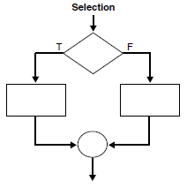
Control Structures
Sequence
Selection
Repetition
Also called “branching”
Allows a block of code to be executed or not based on a “Decision/Question”
Allows for different paths through the code

Slide 32
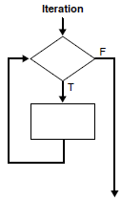
Control Structures
Sequence
Selection
Repetition
Also called “iteration” and “looping”
Allows a block of code to be executed repeatedly until a condition is satisfied

Slide 33
Selection

Slide 34
If
However, it is good practice to go ahead and use them. You might need to add more statements later and forget to add curly braces.
if (boolean expression) { }
if (boolean expression) // single statement
true
Note: Curly braces are optional if there is a single statement.
false

Slide 35
If-else
if (boolean expression) {
// do if true
} else {
// do if false
}
true
false
Note: Curly braces are optional if there is a single statement.

Slide 36
Multiple if-else
Note: Curly braces are optional if there is a single statement.
if (boolean expression) {
// do stuff
} else if (boolean expr) {
// do other stuff
} else {
// do yet other stuff
}
false
false
true
true

Slide 37
See selection.cpp in code directory

Slide 38
Switch
Note: Curly braces are optional if all cases are single statements.
BUT USE THEM ALWAYS.
switch (value) {
case val1:
// do stuff
break;
case val2:
// do other stuff
break;
default:
// yet other stuff
}
true
false
true
false

Slide 39
Switch with fall-through
Note: Curly braces are optional if all cases are single statements.
BUT USE THEM ALWAYS.
switch (value) {
case val1:
// do stuff
case val2:
// do other stuff
break;
default:
// yet other stuff
}
true
false
true
false

Slide 40
Switch
Value used for comparison must be an integer, char, or enumeration.
enumeration := identifier that maps to an integer
When a matching case is found, code is executed until encountering a break. This can result in code for multiple cases executing (fall-through).
Tip: when debugging, check for missing or mistaken break statements.

Slide 41
See switch.cpp in code directory

Slide 42
Repetition

Slide 43
Parts of a Loop
Initialization
Usually of a loop control variable
Continuation condition
Boolean expression specifying when to continue executing the loop
Update
Usually of a loop control variable
Loop Body
Sequence of statements to execute
Iteration := one execution of a sequence of operations or instructions in a repetition. “The program crashes on the 5th iteration”, “How many iterations has it done, so far?”

Slide 44
Creating a Loop
What do things have to look like before entering the loop?
Initialization (control variable)
Initialization (loop body)
How do you exit/end the loop?
Control variable
Continuation condition
Interrupt: break, return, exception
What do you do to ensure you eventually exit/end the loop?
Update
What does the loop do?
Loop Body

Slide 45
While
// initialize
while (continuation condition) {
// loop body
// update
}
Note: Curly braces are optional if there is a single statement.

Slide 46
For
Note: Curly braces are optional if there is a single statement.
// A. initialize
// B. continuation condition
// C. update
for(A; B; C) {
// loop body
}
Bad style to update control variable inside loop.

Slide 47
Types of control
Counting
Control variable increments by set amount each iteration.
Sentinel
Control variable is set to a value obtained during the loop each iteration.
Flag
Control variable is a Boolean variable that represents a condition each iteration.
Special case of sentinel

Slide 48
Do While
// initialize
do {
// loop body
// update (can be initialization)
} while (continuation condition);
Note: Curly braces are optional if there is a single statement.

Slide 49

Loops
Loop type | Minimum times through loop | Maximum times through loop
While | 0
For | 0
Do While | 1
Loop type | Initialization | Update
While | Outside of loop | Within loop body
For | Built into statement | Built into statement
Do While | Outside of loop | Within loop body

Slide 50
Loop conversion
Most loops can be converted to any other type of loop.
What can’t? (Well you could but it would be bad practice)
Good exercise that can help you build good loop structures.
Remember the guidance for building a loop:
Initialize control variable(s)
Specify continuation condition
Specify loop body
Define update for control variable

Slide 51
The Increment and Decrement Operators
++ is the increment operator. It adds one to a variable.
val++; is the same as val = val + 1;
++ can be used before (prefix) or after (postfix) a variable:
++val; val++;

Slide 52
The Increment and Decrement Operators
-- is the decrement operator. It subtracts one from a variable.
val--; is the same as val = val - 1;
-- can be also used before (prefix) or after (postfix) a variable:
--val; val--;

Slide 53
See repetition.cpp in code directory

Slide 54
Prefix vs. Postfix
++ and -- operators can be used in complex statements and expressions
In prefix mode (++val, --val) the operator increments or decrements, then returns the value of the variable
In postfix mode (val++, val--) the operator returns the value of the variable, then increments or decrements

Slide 55
Prefix vs. Postfix - Examples
int num, val = 12;
cout << val++; // displays 12,
// val is now 13;
cout << ++val; // sets val to 14,
// then displays it
num = --val; // sets val to 13,
// stores 13 in num
num = val--; // stores 13 in num,
// sets val to 12

Slide 56
Deciding Which Loop to Use
The while loop is a conditional pretest loop
Iterates as long as a certain condition exits
Validating input
Reading lists of data terminated by a sentinel
The do-while loop is a conditional posttest loop
Always iterates at least once
Repeating a menu
The for loop is a pretest loop
Built-in expressions for initializing, testing, and updating
Situations where the exact number of iterations is known

Slide 57
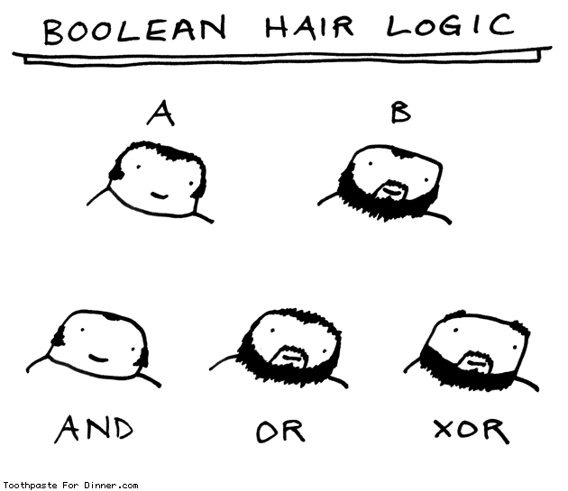

Slide 58
Boolean Expressions

Slide 59
Boolean Values
Logically
True
False
C++
Represented by an integer in the background
false is 0
true is literal 1 by default
Any non-zero value is truthy

Slide 60
Where it is a problem
Some functions that are expected to be Boolean actually return an int.
int isalnum ( int c );
Check if character is alphanumeric (a decimal digit or an uppercase or lowercase letter).
What some students in the past have done
char c = ‘z’;
if (isalnum(c) == true) {
// do something
}
Does not always work
Notes:
Only works for uppercase values

Slide 61
Solution
Don’t compare Boolean-ish functions with true or false.
Boolean-ish: return a value which is not strictly a Boolean value (e.g. int), but is used as if it returns a Boolean.
Just use the value directly as a Boolean without comparing it.
What you should do
char c = ‘z’;
if (isalnum(c)) {
// do something
}
Always works
Notes:
isalnum’s return value tells you what kind of char it is:
1: A-Z
2: a-z
4: 0-9

Slide 62
Boolean Operators
And: &&
Or: ||
Not: !

Slide 63
Boolean Expressions
p && q is true if and only if both p and q are truthy (not 0/false)
&& is Boolean AND
& is bitwise AND operation (does not produce a Boolean value)
p || q is true if and only if either p or q, or both, is truthy (not 0/false).
|| is Boolean OR
| is bitwise OR operation (does not produce a Boolean value)
!p is true if and only if p is false
!p is false if and only if p is truthy (not 0/false)
~ is bitwise negation (1’s complement, does not produce a Boolean value)

Slide 64
Boolean Operators-Examples
int x = 12, y = 5, z = -4;
(x > y) && (y > z) | true
(x > y) && (z > y) | false
(x <= z) || (y == z) | false
(x <= z) || (y != z) | true
!(x >= z) | false

Slide 65
Boolean Operator-Notes
! has highest precedence, followed by &&, then ||
If the value of an expression can be determined by evaluating just the sub-expression on left side of a logical operator, then the sub-expression on the right side will not be evaluated (short circuit evaluation)

Slide 66
See boolean.cpp in code directory

